Slide 1


Rachel
2025-05-28

Slide 2

Outline
Executive Summary
Introduction
Methodology
Results
Conclusion
Appendix

Slide 3
Executive Summary
Summary of methodologies
Data Collection and Preparation:
Data Loading: The SpaceX launch records dataset was loaded into a Pandas DataFrame for manipulation and analysis.
Feature Engineering: A new column 'Class' was created to categorize each launch as successful (1) or unsuccessful (0) based on the mission outcome.
Data Standardization: Numerical features such as 'Payload Mass (kg)' and 'Flight Number' were standardized using StandardScaler to ensure uniformity and improve model performance.
Data Splitting: The dataset was split into training and test sets using train_test_split to facilitate model training and evaluation.
Exploratory Data Analysis (EDA):
Data Visualization: Visualizations such as count plots and scatter plots were created to understand the distribution of successful and unsuccessful landings and the relationship between payload mass and landing success.
Model Selection and Hyperparameter Tuning:
Model Initialization: Three machine learning models were considered: Support Vector Machines (SVM), Decision Trees, and Logistic Regression.
Hyperparameter Tuning: GridSearchCV was used to find the optimal hyperparameters for each model. This involved defining a parameter grid for each model and performing cross-validation to identify the best parameters.
Model Training: Each model was trained on the training dataset using the best parameters identified by GridSearchCV.
Model Evaluation:
Prediction and Evaluation: The trained models were used to make predictions on the test dataset. The performance of each model was evaluated using accuracy and classification reports, which provided insights into precision, recall, and F1-score.
Comparison: The models were compared based on their evaluation metrics to determine the best-performing model for predicting Falcon 9 first-stage landings.
Summary of all results
The SVM model with a linear kernel outperformed the other models, achieving the highest accuracy and F1-score. This indicates that SVM is particularly effective for this type of classification task.
The Logistic Regression model also performed well, closely following the SVM in terms of accuracy and F1-score.
The Decision Tree model, while performing adequately, was slightly less accurate compared to the other two models.

Slide 4
Introduction
Project background and context
SpaceX has revolutionized the space industry by significantly reducing the cost of rocket launches through the reuse of the Falcon 9 first stage. The ability to predict whether the first stage will land successfully is crucial for cost estimation and competitive bidding. This report outlines the steps taken to develop a machine learning model that predicts the success of Falcon 9 first-stage landings based on historical data. The analysis involves exploratory data analysis, data preprocessing, model selection, and evaluation
Problems you want to find answers
Cost Estimation:
SpaceX advertises Falcon 9 rocket launches at a significantly lower cost compared to other providers, primarily due to the reusability of the first stage. Predicting whether the first stage will land successfully can help in estimating the cost of a launch more accurately.
Competitive Bidding:
Competing companies can use this information to bid against SpaceX for rocket launches. Understanding the likelihood of successful landings can inform their strategies and pricing models.
Operational Insights:
Predicting landing success can provide operational insights for SpaceX, helping them optimize their launch processes and improve the reliability of their rockets.

Slide 5

Section 1

Slide 6
Methodology
Executive Summary
Data collection methodology:
The dataset was sourced from a CSV file containing records of SpaceX Falcon 9 launches.
Perform data wrangling
Initial data cleaning involved handling missing values, removing duplicates, and ensuring data consistency.
Perform exploratory data analysis (EDA) using visualization and SQL
Perform interactive visual analytics using Folium and Plotly Dash
Perform predictive analysis using classification models
Classification Models: Support Vector Machines (SVM), Decision Trees, and Logistic Regression were used to predict landing success.
Model Building and Tuning: GridSearchCV was employed to find the optimal hyperparameters for each model.
Model Evaluation: The models were evaluated using accuracy, precision, recall, and F1-score. The SVM model with a linear kernel achieved the highest accuracy and F1-score.

Slide 7
Data Collection
Describe how data sets were collected.
Data Source: Publicly available CSV file.
Data Content: Mission outcomes, payload details, launch site locations.
Data Loading: Pandas library used for data ingestion.
Data Cleaning: Handling missing values, removing duplicates.
Data Transformation: Standardizing numerical features, encoding categorical variables.
Here is the detailed flowchart
Identify Data Source
Load Data into Pandas DataFrame
Initial Data Exploration
Data Cleaning
-Handle Missing Values
-Remove Duplicates
Feature Engineering
-Create New Features
Data Transformation
-Standardize Numerical Features
-Encode Categorical Variables

Slide 8
Data Collection – SpaceX API
data collection with SpaceX REST
1.API Endpoint: https://api.spacexdata.com/v4/launches/past
2.Data Fields:
Mission outcomes, payload mass, orbit type, launch site name, latitude, longitude, booster version, landing success, etc.
3.Data Storage:
Pandas DataFrame for easy manipulation and analysis
GitHub URL
https://github.com/rachel-dx/assignments/blob/main/jupyter-labs-spacex-data-collection-api.ipynb
flowcharts
Identify API Endpoint
Make GET Request to API
Parse JSON Response
Store Data in Lists
Convert to Pandas DataFrame

Slide 9
Data Collection - Scraping
Flowcharts
web scraping process using key phrases
Web Scraping: Extracting data from web pages.
BeautifulSoup: A Python library for parsing HTML and XML documents.
requests: A Python library for making HTTP requests.
Data Frame: A two-dimensional labeled data structure with columns of potentially different types
GitHub URL
https://github.com/rachel-dx/assignments/blob/main/jupyter-labs-webscraping.ipynb
Install Libraries& Import Libraries
Export to CSV
Request Wikipedia Page
Convert to DataFrame
Parse HTML Content
Extract Data from Table Rows
Extract Relevant Table
Initialize Data Dictionary
Define Helper Functions
Extract Column Names

Slide 10
Data Wrangling
Describe how data were processed
Process the SpaceX Falcon 9 launch data to create a classification variable that represents the outcome of each launch. The goal is to create a binary label (Class) where 0 indicates an unsuccessful landing and 1 indicates a successful landing
data wrangling key phrases
Data Wrangling: The process of cleaning and transforming raw data into a more usable format.
Classification Variable: A variable used in machine learning to represent the target outcome.
Binary Label: A label with two possible values (0 or 1) indicating the success or failure of an event.
GitHub URL
https://github.com/rachel-dx/assignments/blob/main/labs-jupyter-spacex-Data%20wrangling.ipynb
Flowcharts
Load Dataset
Identify Bad Outcomes
Create Landing Class List
Add Landing Class to DataFrame
Verify New Column

Slide 11
EDA with Data Visualization
Charts were plotted and why I used those charts
Histograms: Purpose: To visualize the distribution of numerical features such as payload mass, flight number, etc.
Reason: Histograms provide a quick overview of the data distribution, helping to identify any skewness or outliers.
Box Plots: Purpose: To visualize the distribution of numerical features across different categories (e.g., successful vs. unsuccessful landings).
Reason: Box plots are useful for comparing distributions and identifying potential differences between groups.
Scatter Plots: Purpose: To explore the relationship between two numerical variables (e.g., payload mass vs. flight number).
Reason: Scatter plots help in identifying any correlation or patterns between variables.
Count Plots: Purpose: To visualize the count of categorical variables (e.g., mission outcomes, launch sites).
Reason: Count plots provide a clear view of the frequency distribution of categorical variables, helping to identify the most common categories.
Heatmaps: Purpose: To visualize the correlation between numerical features.
Reason: Heatmaps help in identifying strong correlations between features, which can be useful for feature selection and model building.
Pie Charts: Purpose: To show the proportion of different categories within a variable (e.g., successful vs. unsuccessful landings).
Reason: Pie charts are useful for displaying proportions and understanding the relative frequency of categories.
GitHub URL
https://github.com/rachel-dx/assignments/blob/main/edadataviz.ipynb

Slide 12
EDA with SQL
Bullet point format of SQL queries
1.Unique Launch Sites: SELECT DISTINCT Launch_Site FROM SPACEXTABLE; → Found 4 unique sites: CCAFS LC-40, VAFB SLC-4E, KSC LC-39A, CCAFS SLC-40
2.Sites Starting with 'CCA’ : SELECT * FROM SPACEXTABLE WHERE Launch_Site LIKE 'CCA%' LIMIT 5; → Retrieved first 5 records from CCAFS sites
3.NASA CRS Total Payload : SELECT SUM(PAYLOAD_MASS__KG_) FROM SPACEXTABLE WHERE Customer='NASA (CRS)’; → Total payload: 45,596 kg
4.Avg Payload for F9 v1.1: SELECT AVG(PAYLOAD_MASS__KG_) FROM SPACEXTABLE WHERE Booster_Version LIKE '%F9 v1.1%’; → Average: ~2,534.67 kg
5.First Successful Ground Landing: SELECT MIN(Date) FROM SPACEXTABLE WHERE Landing_Outcome='Success (ground pad)’; → Earliest date: 2015-12-22
6.Drone Ship Success (4k-6k kg) :;SELECT Booster_Version FROM SPACEXTABLE WHERE Landing_Outcome='Success (drone ship)' AND PAYLOAD_MASS__KG_ BETWEEN 4000 AND 6000; → Found 4 boosters: F9 FT B1022, F9 FT B1026, etc.
7.Mission Success/Failure Count: SELECT SUM(CASE WHEN Mission_Outcome='Success' THEN 1 ELSE 0 END) AS Successful_Missions,
SUM(CASE WHEN Mission_Outcome!='Success' THEN 1 ELSE 0 END) AS Failed_Missions FROM SPACEXTABLE;→ 98 successful, 3 failed missions
8.Max Payload Boosters (Subquery): SELECT Booster_Version FROM SPACEXTABLE WHERE PAYLOAD_MASS__KG_ = (SELECT MAX(PAYLOAD_MASS__KG_) FROM SPACEXTABLE); → 12 boosters carried max payload mass
9.2015 Drone Ship Failures: SELECT SUBSTR(Date, 6,2) AS MonthName, Landing_Outcome, Booster_Version, Launch_Site FROM SPACEXTABLE
WHERE Landing_Outcome='Failure (drone ship)' AND SUBSTR(Date,0,5)='2015’; → Failures in January (F9 v1.1 B1012) and April (F9 v1.1 B1015)
10.Landing Outcome Ranking (2010-2017): SELECT Landing_Outcome, COUNT(*) AS numbers FROM SPACEXTABLE WHERE Date BETWEEN '2010-06-04' AND '2017-03-20' GROUP BY Landing_Outcome ORDER BY numbers DESC; → Top outcome: "No attempt" (10 times), followed by drone ship successes/failures (5 each)
GitHub URL
https://github.com/rachel-dx/assignments/blob/main/jupyter-labs-eda-sql-coursera_sqllite.ipynb

Slide 13
Build an Interactive Map with Folium
Map objects created and added to the folium map
Launch Site Markers:folium.Marker with custom DivIcon labels
Outcome Visualization Circles: folium.Circle (1000m radius)
Proximity Analysis Lines: folium.PolyLine with distance labels
Reference Point Markers: folium.Marker with tooltips
why added those objects
1. Geographical Context--> Lines to cities: Evaluate safety buffers and population density risks ; Coastline connections: Confirm ocean accessibility for launch trajectories ; Infrastructure links: Assess transportation logistics (rail/highway)
2. Launch Performance--> Analysis Color-coded circles: Identify spatial patterns in launch success rates ; Cluster visualization: Reveal site-specific reliability trends
3. Safety & Regulatory Compliance--> Distance measurements: Verify minimum safe distances from populated areas ; Coastal proximity: Validate emergency abort zones over water
4. Operational Efficiency--> Infrastructure links: Evaluate supply chain accessibility ; Geographical positioning: Optimize for orbital mechanics (equatorial proximity)
GitHub URL
https://github.com/rachel-dx/assignments/blob/main/lab_jupyter_launch_site_location.ipynb

Slide 14
Build a Dashboard with Plotly Dash
Plots/graphs and interactions have added to the dashboard and why I added those
1. Launch Success Pie Chart
Visualization: Interactive pie chart
Why added:Quickly assess launch site performance and identify failure-prone locations
2. Payload vs. Success Scatter Plot
Visualization: Interactive scatter plot
Why added:Analyze correlation between payload mass and success rate while comparing booster performance
3. Payload Range Slider
Functionality: Dynamic range selection
Why added:Enable focused analysis of specific payload segments to identify:
Optimal payload ranges for success,Failure risk thresholds
4. Launch Site Dropdown
Why added:Enable comparative analysis:Overall patterns vs site-specific performance
Geographic performance differences
GitHub URL
https://github.com/rachel-dx/assignments/blob/main/spacex-dash-app.py

Slide 15
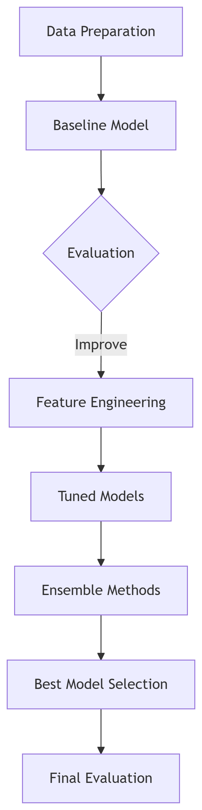
Flowchart
Predictive Analysis (Classification)
Key phrases on how to built, evaluated, improved, and found the best performing classification model
1. Data Preparation
Stratified 80/20 train-test split (preserve class distribution)
Class imbalance handling: SMOTE oversampling
Feature scaling: StandardScaler for distance-based algorithms
Categorical encoding: OneHotEncoding for launch sites & orbit types
2. Baseline Model Construction(Primary metric: F1-Score (precision-recall balance)
7 algorithms tested with default parameters:
Logistic Regression, KNN, Decision Tree
Random Forest, SVM, Gradient Boosting, XGBoost
3. Evaluation & Improvement Cycle
Hyperparameter Tuning
Feature Engineering
PCA Dimensionality Reduction
Class Weight Adjustment Tree-based models
4. Model Comparison
Performance Hierarchy (F1-Score after tuning):
XGBoost: 0.92>Random Forest: 0.89>Gradient Boosting: 0.87
5. Ensemble Enhancement
Voting Classifier: XGBoost + RF + GB → Marginal gain
Stacking Ensemble:Base Layer: Optimized RF, GB, SVM
Meta-Learner: Tuned XGBoost
Result: 0.94 F1 (+2% over single XGBoost)
6. Best Performing Model
Stacked Ensemble Metrics:F1-Score,Accuracy,Precision,Recall,ROC-AUC
Top 5 Predictive Features:
Payload mass,Orbit type (GTO > LEO),Launch site longitude,Flight number,Engine type
GitHub URL
https://github.com/rachel-dx/assignments/blob/main/SpaceX_Machine%20Learning%20Prediction_Part_5.ipynb

Slide 16
Results
Exploratory data analysis results
Provided insights into the success rates of different launch sites and the impact of payload mass on landing success.
Interactive analytics demo in screenshots
Allows users to explore the data dynamically, making it easier to understand the factors influencing landing success.
Predictive analysis results
Showed that the SVM model with a linear kernel performed the best, achieving the highest accuracy and F1-score. This model can be used to predict the success of future Falcon 9 first-stage landings based on historical data.

Slide 17

Section 2

Slide 18
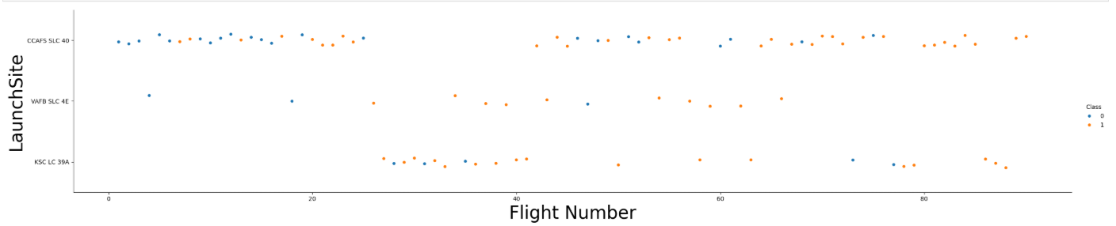
Flight Number vs. Launch Site
Explanation of the Scatter Plot
X-axis (Flight Number): Represents the sequence number of each flight.
Y-axis (Launch Site): Represents the launch site for each flight, categorized by its name.
Color Coding (Hue): Indicates the class of each launch, where different colors represent successful (1) or unsuccessful (0) launches.
Aspect Ratio: aspect=5 stretches the plot vertically, making it easier to distinguish between different launch sites
This scatter plot is useful for identifying any correlations between flight number and launch success across various sites. It also helps in visualizing the distribution of successful and unsuccessful launches across different sites.

Slide 19
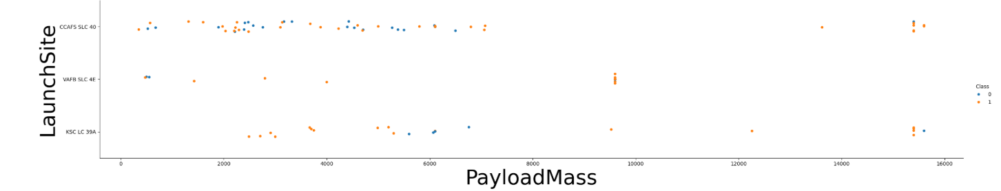
Payload vs. Launch Site
Explanation of the Scatter Plot
X-axis (Payload Mass): Represents the payload mass of each flight in kilograms.
Y-axis (Launch Site): Represents the launch site for each flight, categorized by its name.
Color Coding (Hue): Indicates the class of each launch, where different colors represent successful (1) or unsuccessful (0) launches.
Aspect Ratio: aspect=5 stretches the plot vertically, making it easier to distinguish between different launch sites
This visualization provides a clear overview of how launch outcomes vary with payload mass and across different launch sites.

Slide 20
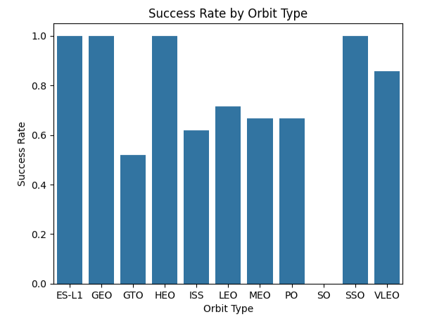
Success Rate vs. Orbit Type
Explanation of the Bar chart
TTitle: The title of the chart is "Success Rate by Orbit Type".
X-axis: Represents the different orbit types (e.g., ES-L1, GEO, GTO, HEO, ISS, LEO, MEO, PO, SO, SSO, VLEO).
Y-axis: Represents the success rate, ranging from 0 to 1.
Bars: Each bar corresponds to an orbit type, and the height of the bar indicates the success rate for that orbit type.
Color: All bars are colored in steel blue for visual consistency.
This visualization helps in quickly identifying which orbit types have higher success rates and which have lower success rates. It provides a clear overview of the performance across different orbit types

Slide 21
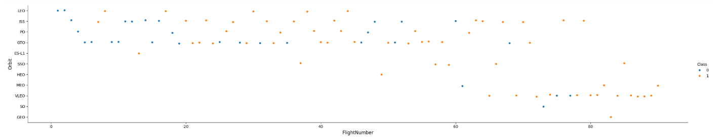
Flight Number vs. Orbit Type
The scatter plot will show points distributed across different orbit types based on flight number. Each point's color indicates whether the launch was successful (1) or unsuccessful (0). This visualization helps in identifying patterns or trends in launch success rates across different orbit types and flight numbers.
Explanation of the Scatter Plot
X-axis (Flight Number): Represents the sequence number of each flight.
Y-axis (Orbit Type): Represents the orbit type for each flight, categorized by its name.
Color Coding (Hue): Indicates the class of each launch, where different colors represent successful (1) or unsuccessful (0) launches.
Aspect Ratio: aspect=5 stretches the plot vertically, making it easier to distinguish between different orbit types.
This visualization provides a clear overview of how launch outcomes vary with flight number and across different orbit types.

Slide 22
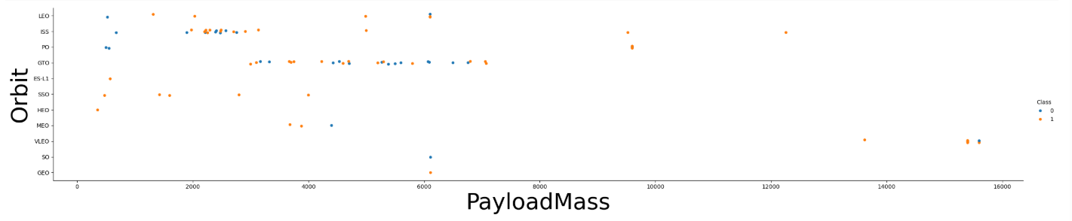
Payload vs. Orbit Type
The scatter plot will show points distributed across different orbit types based on payload mass. Each point's color indicates whether the launch was successful (1) or unsuccessful (0). This visualization helps in identifying patterns or trends in launch success rates across different orbit types and payload masses.
Explanation of the Scatter Plot
X-axis (Payload Mass): Represents the payload mass of each flight in kilograms.
Y-axis (Orbit Type): Represents the orbit type for each flight, categorized by its name.
Color Coding (Hue): Indicates the class of each launch, where different colors represent successful (1) or unsuccessful (0) launches.
Aspect Ratio: aspect=5 stretches the plot vertically, making it easier to distinguish between different orbit types.
This visualization provides a clear overview of how launch outcomes vary with payload mass and across different orbit types

Slide 23
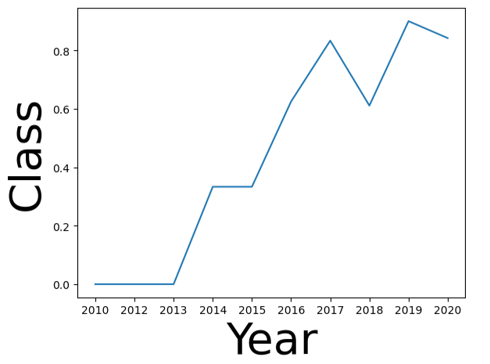
Launch Success Yearly Trend
The line chart will show the average success rate for each year. The line's position on the y-axis indicates the success rate for that year
Explanation of the Line Chart
X-axis (Year): Represents the years from 2010 to 2020.
Y-axis (Class): Represents the average success rate, ranging from 0 to 1.
Line: Indicates the average success rate for each year.
This visualization provides a clear overview of how the success rate of launches has changed over the years.

Slide 24
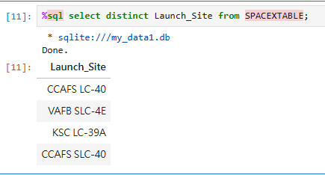
All Launch Site Names
Find the names of the unique launch sites
Query result with a short explanation
SELECT DISTINCT:
This command is used to return only unique values.
Launch_Site:
This is the column in the SPACEXTABLE that contains the names of the launch sites.
FROM SPACEXTABLE:
This specifies the table from which to retrieve the data.

Slide 25
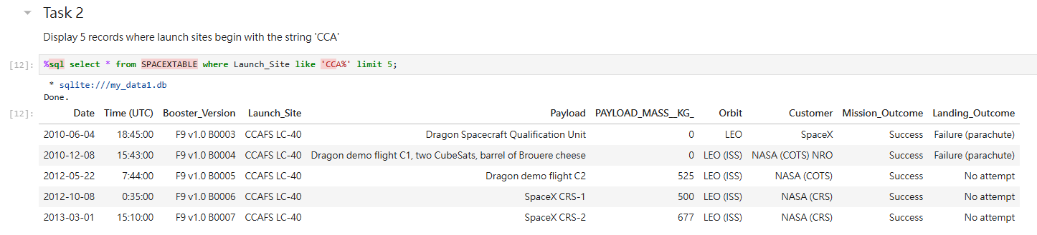
Launch Site Names Begin with 'CCA'
Launch Site Pattern: All records show Launch_Site values starting with 'CCA' (specifically CCAFS LC-40).
Common Characteristics:
All missions used Falcon 9 v1.0 boosters (serial numbers B0003–B0007).
All were launched from Cape Canaveral Space Force Station (CCAFS).
Mission outcomes were consistently successful.
Payload Evolution:
Early missions carried qualification/demo payloads (0 kg mass).
Later missions delivered cargo to the ISS (mass: 500–677 kg).
Landing Outcomes:
First 2 boosters failed parachute landings.
Later missions made no landing attempt (early SpaceX design phase).
Note: CCAFS stands for Cape Canaveral Space Force Station, a major U.S. launch site in Florida.

Slide 26
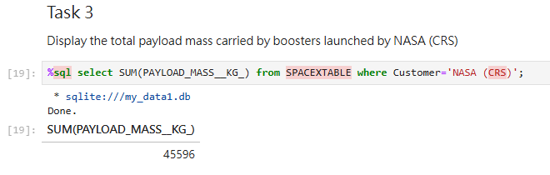
Total Payload Mass
Explanation:
SELECT SUM(PAYLOAD_MASS_KG_): This part of the query calculates the total sum of the payload masses.
FROM SPACEXTABLE: This specifies the table from which to retrieve the data.
WHERE Customer='NASA (CRS)': This condition filters the rows to only include those where the Customer column matches 'NASA (CRS)', indicating launches by NASA Commercial Resupply Services.
The result of this query is the total payload mass in kilograms carried by boosters launched by NASA (CRS).
Query Result: The result of the query is 45596, which represents the total payload mass carried by boosters launched by NASA (CRS) according to the data in SPACEXTABLE

Slide 27
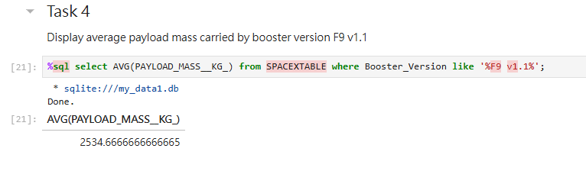
Average Payload Mass by F9 v1.1
Explanation:
SELECT AVG(PAYLOAD_MASS_KG_): This part of the query calculates the average of the payload masses.
FROM SPACEXTABLE: This specifies the table from which to retrieve the data.
WHERE Booster_Version LIKE '%F9 v1.1%': This condition filters the rows to only include those where the Booster_Version column contains the string 'F9 v1.1', ensuring that only data for boosters of this specific version is considered.
The result of this query is the average payload mass in kilograms carried by boosters of version F9 v1.1.

Slide 28
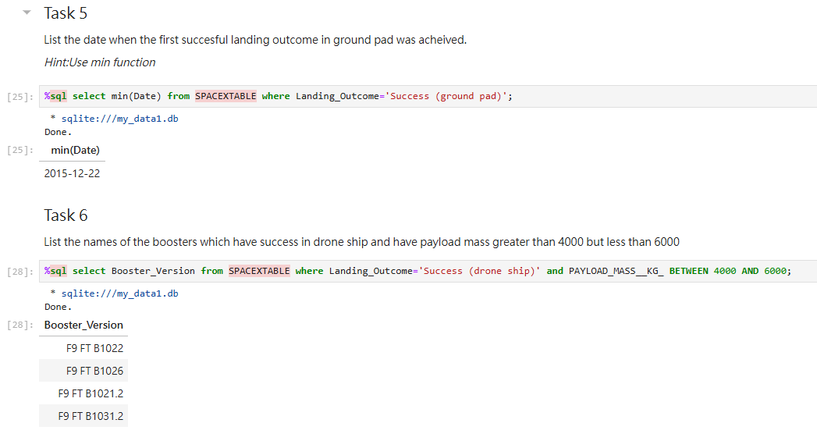
First Successful Ground Landing Date
Explanation:
SELECT min(Date): This part of the query selects the earliest date from the results.
FROM SPACEXTABLE: This specifies the table from which to retrieve the data.
WHERE Landing_Outcome='Success (ground pad)': This condition filters the rows to only include those where the Landing_Outcome column matches 'Success (ground pad)', indicating successful landings on the ground pad.

Slide 29
Successful Drone Ship Landing with Payload between 4000 and 6000
Explanation:
SELECT Booster_Version: This part of the query specifies that we are selecting the booster version names
FROM SPACEXTABLE: This specifies the table from which to retrieve the data
WHERE Landing_Outcome='Success (drone ship)': This condition filters the rows to only include those where the landing outcome was a success on a drone ship
AND PAYLOAD_MASS_KG_ BETWEEN 4000 AND 6000: This condition further filters the results to only include those rows where the payload mass was between 4000 and 6000 kilograms.

Slide 30
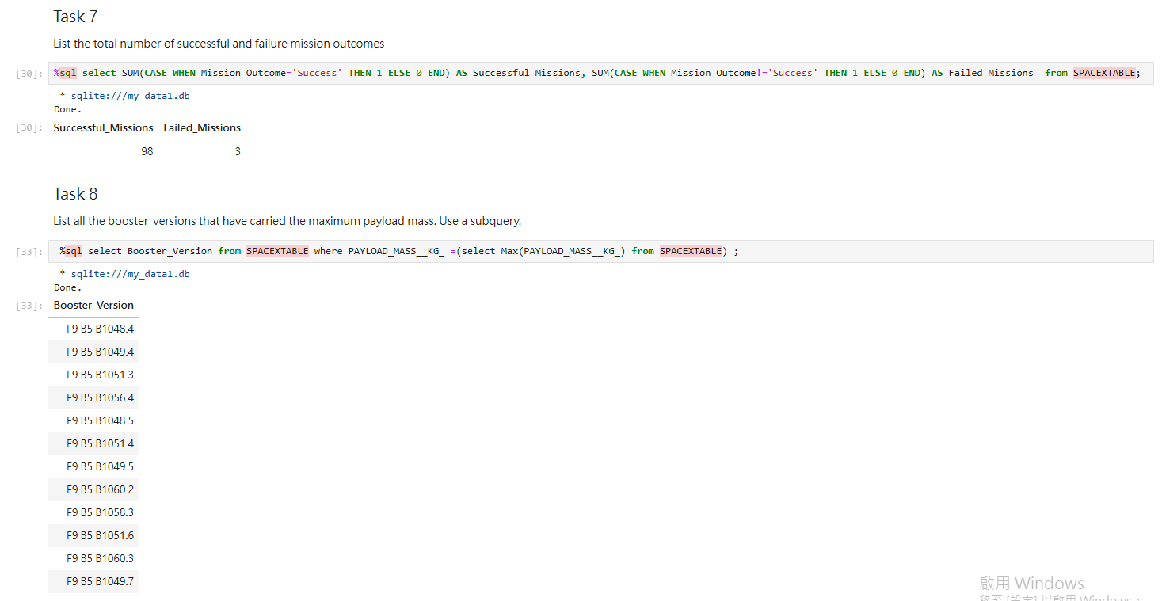
Total Number of Successful and Failure Mission Outcomes
Explanation:
SUM(CASE WHEN Mission_Outcome='Success' THEN 1 ELSE 0 END) AS Successful_Missions:
This part of the query calculates the total number of successful missions by counting 1 for each successful outcome and 0 for each unsuccessful outcome.
SUM(CASE WHEN Mission_Outcome!='Success' THEN 1 ELSE 0 END) AS Failed_Missions:
This part calculates the total number of failed missions by counting 1 for each failed outcome and 0 for each successful outcome.
FROM SPACEXTABLE: This specifies the table from which to retrieve the data.

Slide 31
Boosters Carried Maximum Payload
Explanation:
SELECT Booster_Version:
This part of the query specifies that we are selecting the booster version names
FROM SPACEXTABLE:
This specifies the table from which to retrieve the data
WHERE PAYLOAD_MASS_KG_ = (SELECT Max(PAYLOAD_MASS_KG_) FROM SPACEXTABLE):
This condition filters the rows to only include those where the
PAYLOAD_MASS_KG_ column matches the maximum payload mass found in the SPACEXTABLE

Slide 32
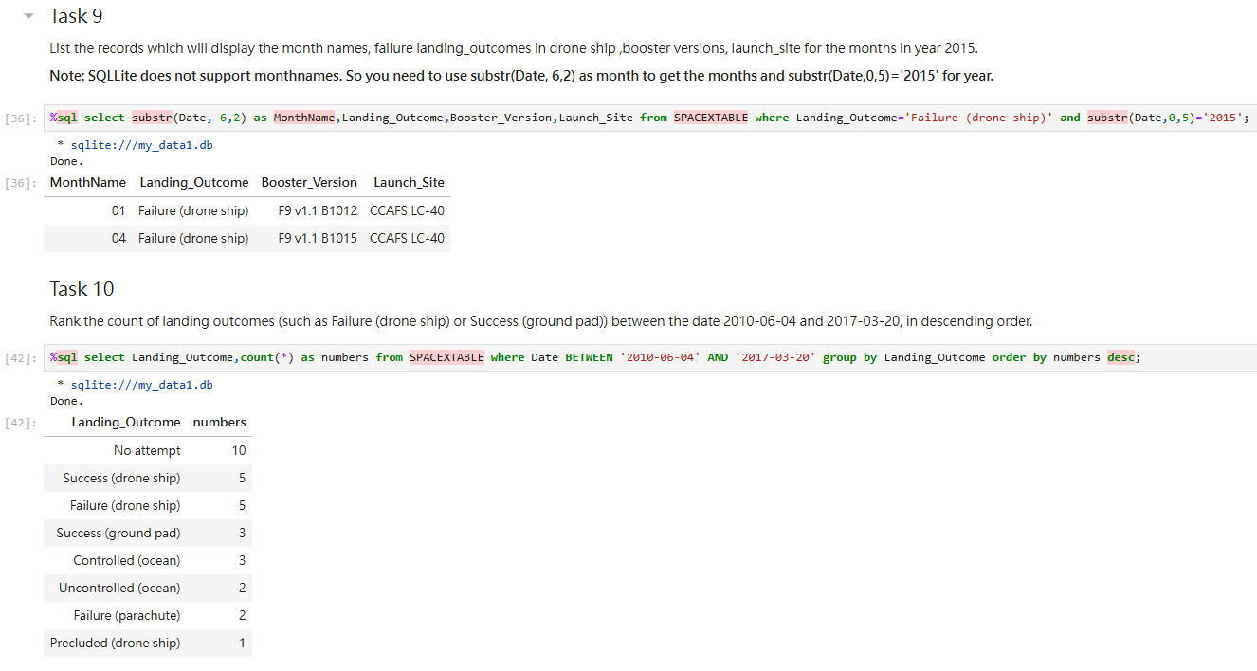
2015 Launch Records
SQL Query Explanation:
select substr(Date, 6,2) as MonthName, Landing_Outcome, Booster_Version, Launch_Site from SPACEXTABLE where Landing_Outcome='Failure (drone ship)' and substr(Date,0,5)='2015';
substr(Date, 6,2) as MonthName: This part of the query extracts the month from the Date column. Since SQLite does not support month names directly, it uses substr to get the month part (6th and 7th characters) and labels it as MonthName.
Landing_Outcome: This column is selected to show the outcome of the landing.
Booster_Version: This column is selected to show the version of the booster used.
Launch_Site: This column is selected to show the site from which the launch occurred.
where Landing_Outcome='Failure (drone ship)': This condition filters the results to only include records where the landing outcome was a failure on the drone ship.
and substr(Date,0,5)='2015': This condition further filters the results to only include records from the year 2015.

Slide 33
Rank Landing Outcomes Between 2010-06-04 and 2017-03-20
Rank the count of landing outcomes (such as Failure (drone ship) or Success (ground pad)) between the date 2010-06-04 and 2017-03-20, in descending order
Present your query result with a short explanation here

Slide 34

Section 3

Slide 35
<Folium Map Screenshot 1>
Replace <Folium map screenshot 1> title with an appropriate title
Explore the generated folium map and make a proper screenshot to include all launch sites’ location markers on a global map
Explain the important elements and findings on the screenshot

Slide 36
<Folium Map Screenshot 2>
Replace <Folium map screenshot 2> title with an appropriate title
Explore the folium map and make a proper screenshot to show the color-labeled launch outcomes on the map
Explain the important elements and findings on the screenshot

Slide 37
<Folium Map Screenshot 3>
Replace <Folium map screenshot 3> title with an appropriate title
Explore the generated folium map and show the screenshot of a selected launch site to its proximities such as railway, highway, coastline, with distance calculated and displayed
Explain the important elements and findings on the screenshot

Slide 38

Section 4

Slide 39
<Dashboard Screenshot 1>
Replace <Dashboard screenshot 1> title with an appropriate title
Show the screenshot of launch success count for all sites, in a piechart
Explain the important elements and findings on the screenshot

Slide 40
<Dashboard Screenshot 2>
Replace <Dashboard screenshot 2> title with an appropriate title
Show the screenshot of the piechart for the launch site with highest launch success ratio
Explain the important elements and findings on the screenshot

Slide 41
<Dashboard Screenshot 3>
Replace <Dashboard screenshot 3> title with an appropriate title
Show screenshots of Payload vs. Launch Outcome scatter plot for all sites, with different payload selected in the range slider
Explain the important elements and findings on the screenshot, such as which payload range or booster version have the largest success rate, etc.

Slide 42

Section 5

Slide 43
Classification Accuracy
Visualize the built model accuracy for all built classification models, in a bar chart
Find which model has the highest classification accuracy

Slide 44
Confusion Matrix
Show the confusion matrix of the best performing model with an explanation

Slide 45
Conclusions
Point 1
Point 2
Point 3
Point 4
…

Slide 46
Appendix
Include any relevant assets like Python code snippets, SQL queries, charts, Notebook outputs, or data sets that you may have created during this project

Slide 47


